Slide 1
CT Real Estate Review
Data Analysis review of single-family sales price & venues in Connecticut, U.S

Slide 2
Data Analysis review of single-family sales price & venues in Connecticut, U.S
Introduction
Description & Background
Data Description
Methodology
Discussion
Conclusion

Slide 3
Introduction: Description & Background
A Residential Real Estate Firm is determining which county of Connecticut, U.S.A to start their business in based on Single Family Home sales, Housing Sale Prices and top venue categories. The goal of the firm is to determine which county will yield the highest profit.
Connecticut (CT) stats:
Southern New England, U.S.A
Resides along the Atlantic coast
5,018 square mile state
Population estimate is approximately 3.5 million
Population per square mile 738.1.

Slide 4
Introduction: Data Description
CT Real Estate statistics via Google web search. URL includes a table reviewing single family homes ranging from 2016-2019. Data was cleaned to review year 2019 only.
https://www.connecticutmag.com/issues/features/real-estate-2020-the-stats-on-connecticut-towns-and-cities/article_5b21a36a-687b-11ea-8a7e-534f5cf472a2.html
Forsquare API was used to identify the most common venues in Fairfield County, CT
Geospatial data was plotted via merge of Excel Spreadsheet CSV
Excel Geography Data Type was utilized to determine Latitude and Longitude coordinates of Counties in CT.
IBM Watson Studio data base and pushed Gist to Github

Slide 5
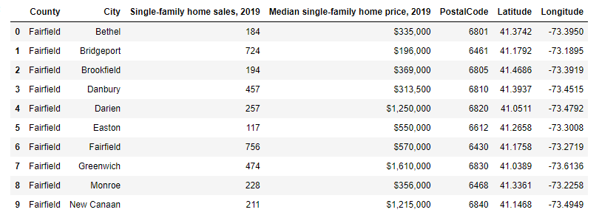
Methodology
Master data has components County, City, Single-family home sales, 2019, Median single-family home price, 2019 information of each city in Connecticut
Merged the CT city Latitude and Longitude Excel CSV into my data set
Sorted the top values by Median single-family home price, 2019, this returned all 10 top values within Fairfield County

Slide 6
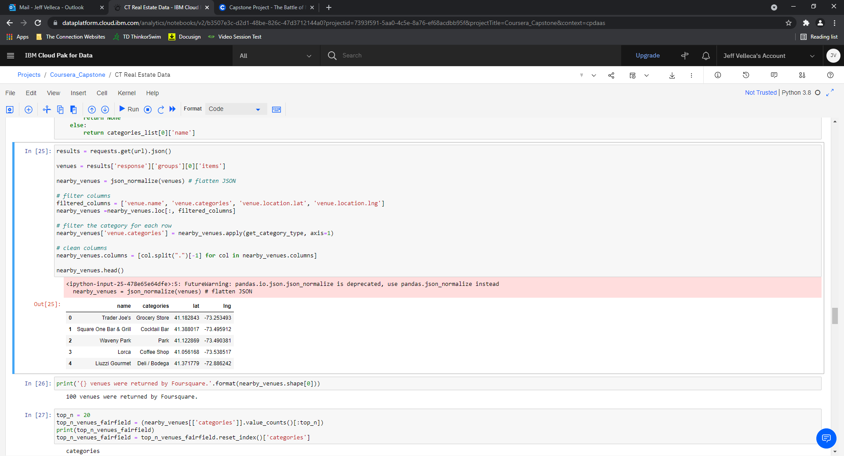
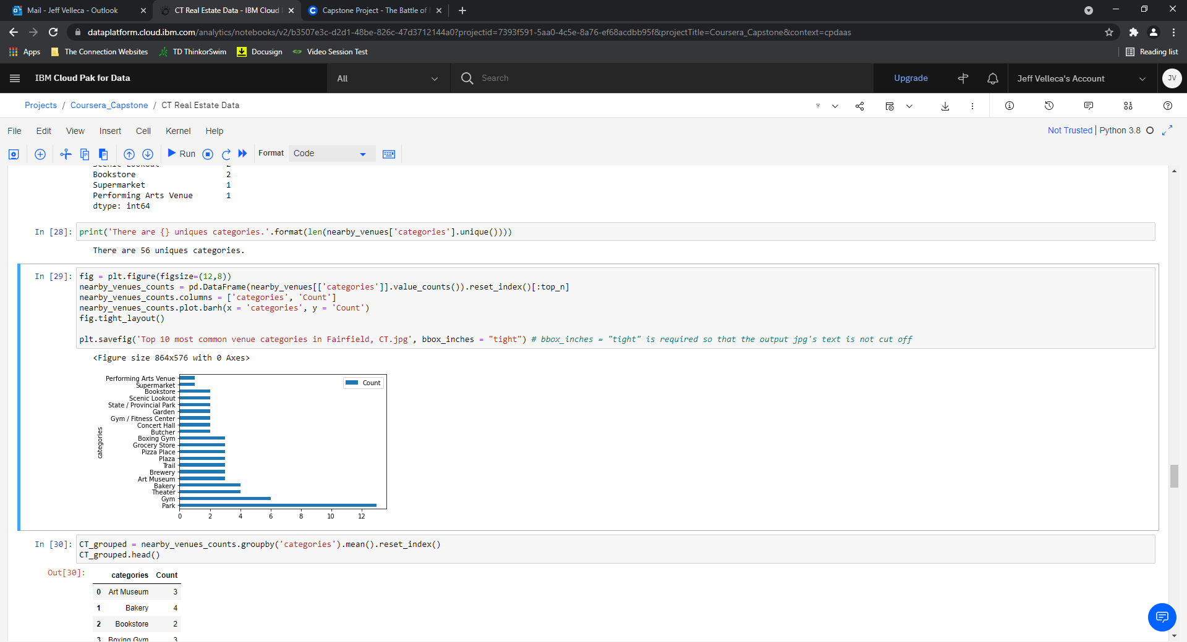
Methodology Continued
I utilized the Forsquare API to explore the top venues in Fairfield County. I designed the limit as 100 venues and the radius 100000 meter from the center point Latitude and Longitude of Fairfield County. See below head of the list venues name, category, latitude and longitude information from Forsquare API.
In summary of this data there were 100 venues returned by Forsquare. Here is a chart review of the top 20 venue categories by value count.

Slide 7
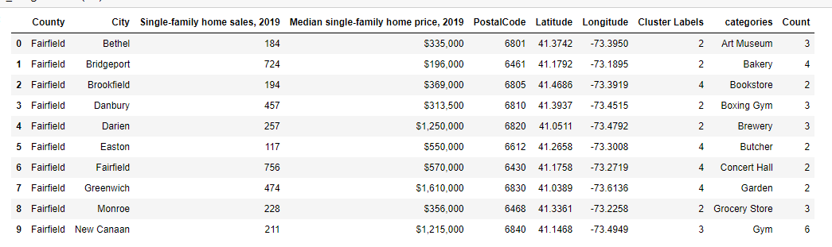
Methodology Continued
We can see for Fairfield County there are several different types of venues that provide vast opportunity for venue investment types but there are some commonalities that allow for clustering.
Due to having some commonality in venue categories for Fairfield County CT, I used unsupervised learning K-means algorithm to cluster the venues. K-Means algorithm is one of the most common cluster methods of unsupervised learning.
I clustered the venue categories into 5 Clusters, I then merged the original CT Real Estate data frame that with the newly created venue cluster categories which returned the below table.

Slide 8
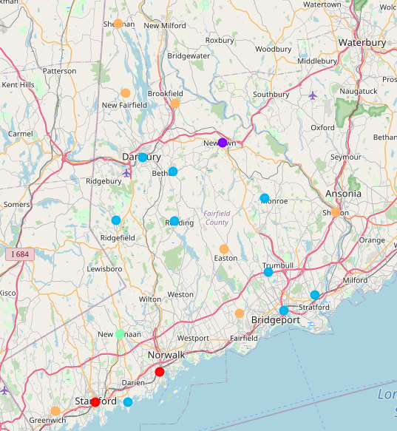
Geospatial Data
Folium library was used to visualize geographic details of Fairfield County, Connecticut including the resulting 5 Clusters of Venue categories

Slide 9
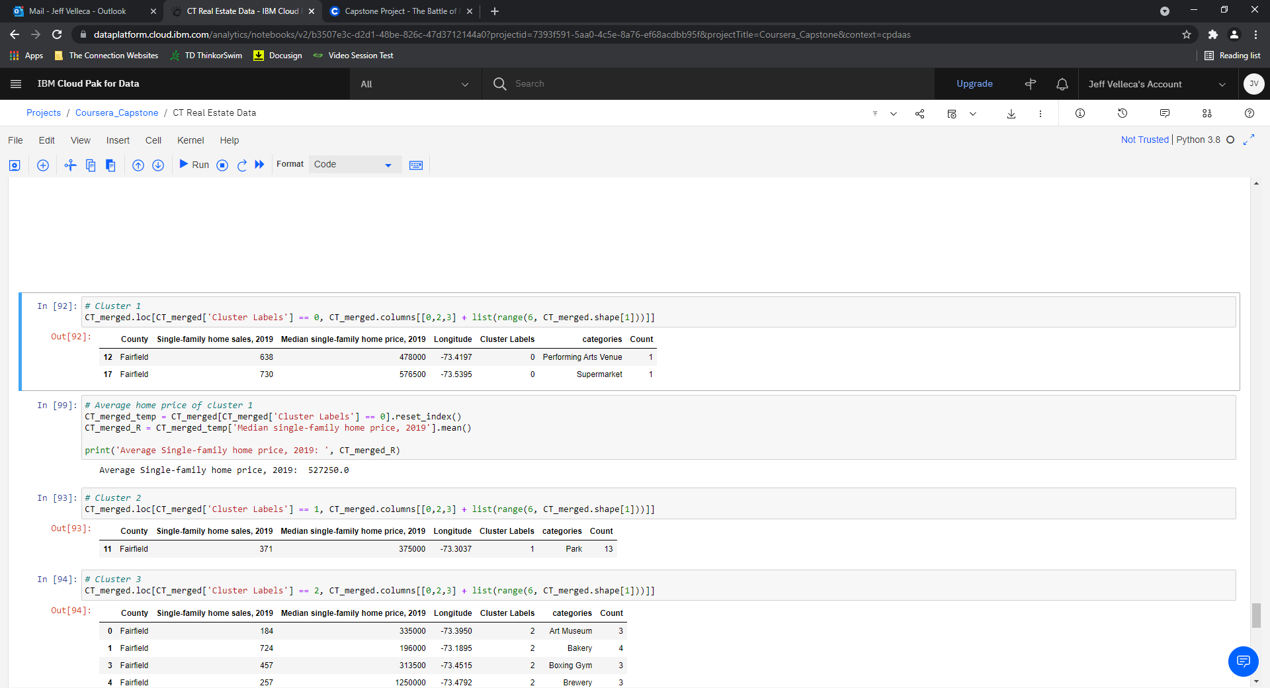
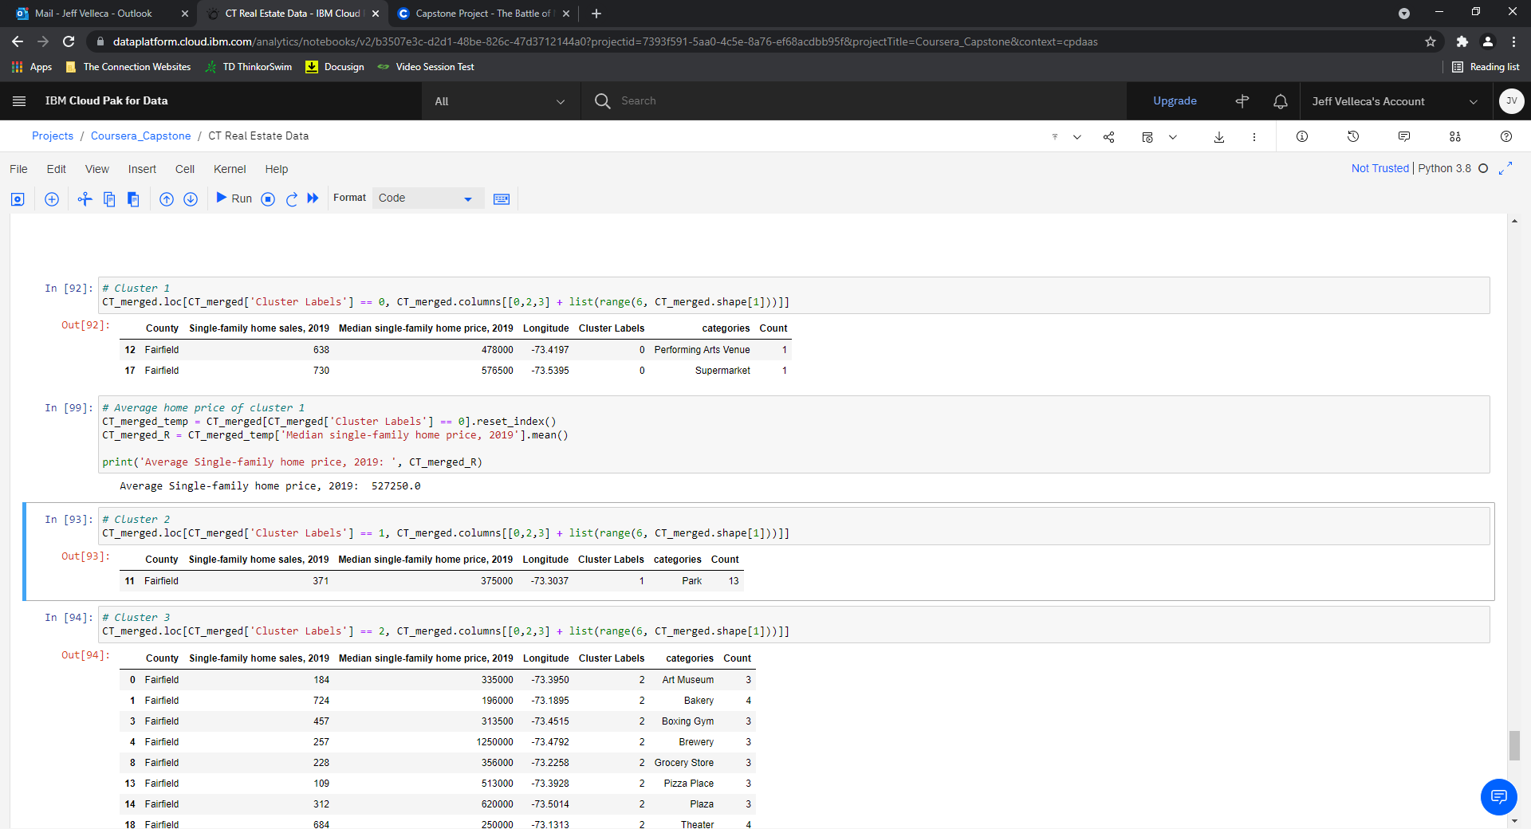
Venue Category Clusters (Fairfield County)
Venue Categories in Fairfield County with the highest Single-family home price, 2019.
5 Clusters returned
Cluster 1
Cluster 2

Slide 10
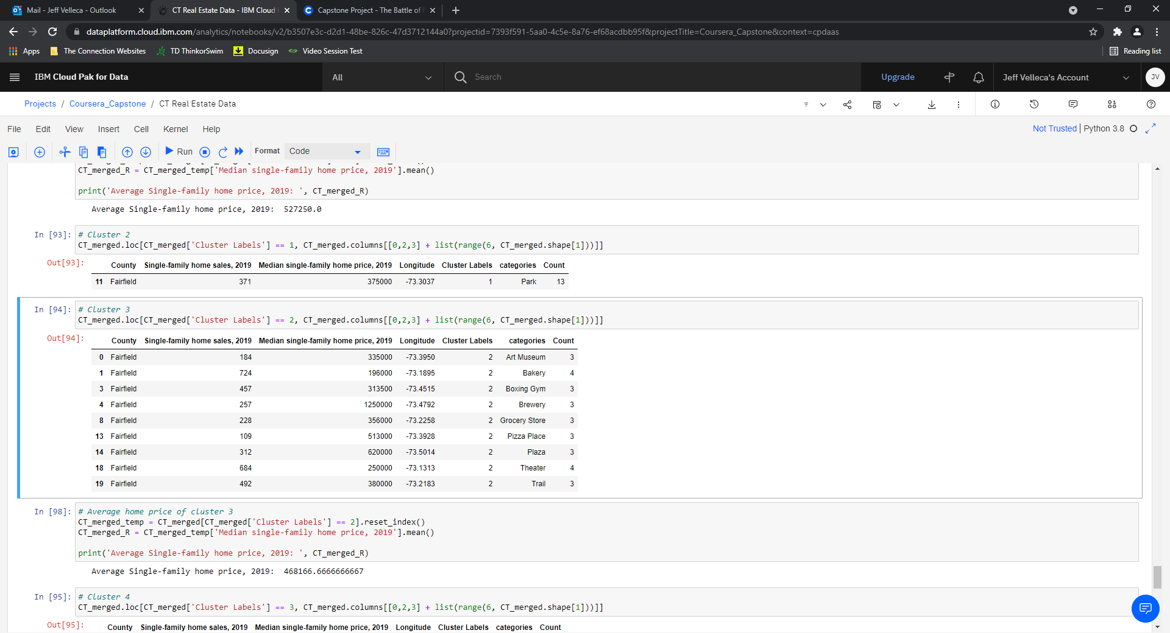
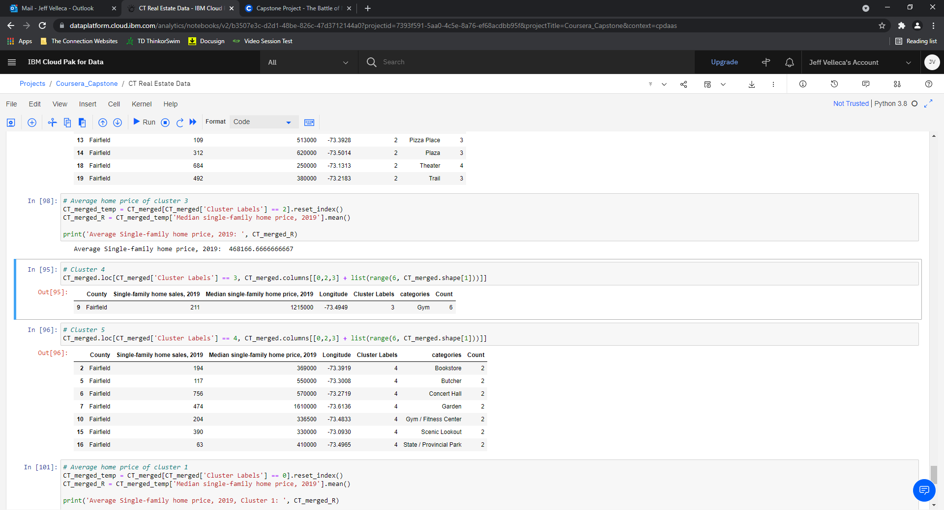
Clusters Continued
Cluster 3
Cluster 4

Slide 11
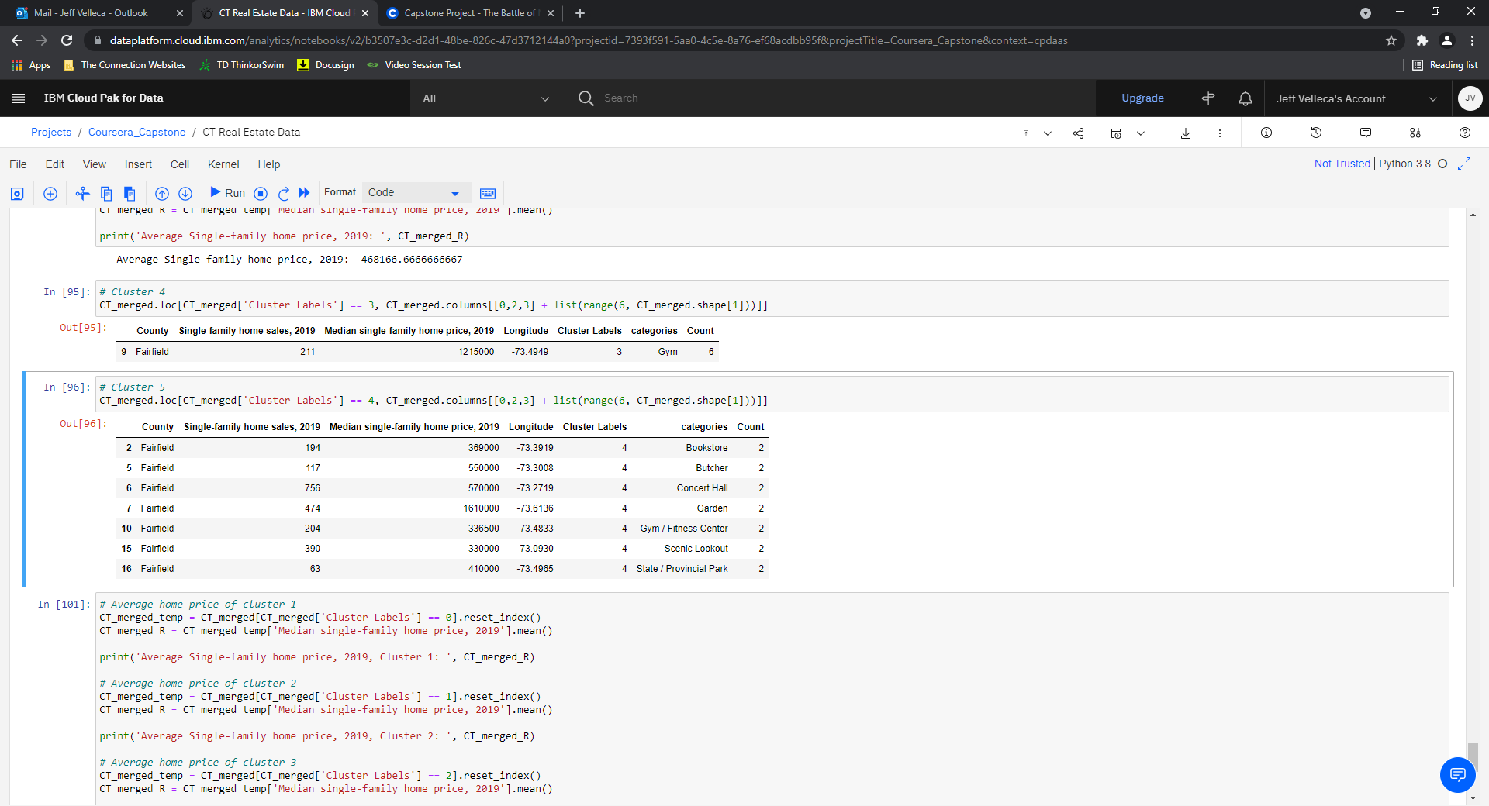
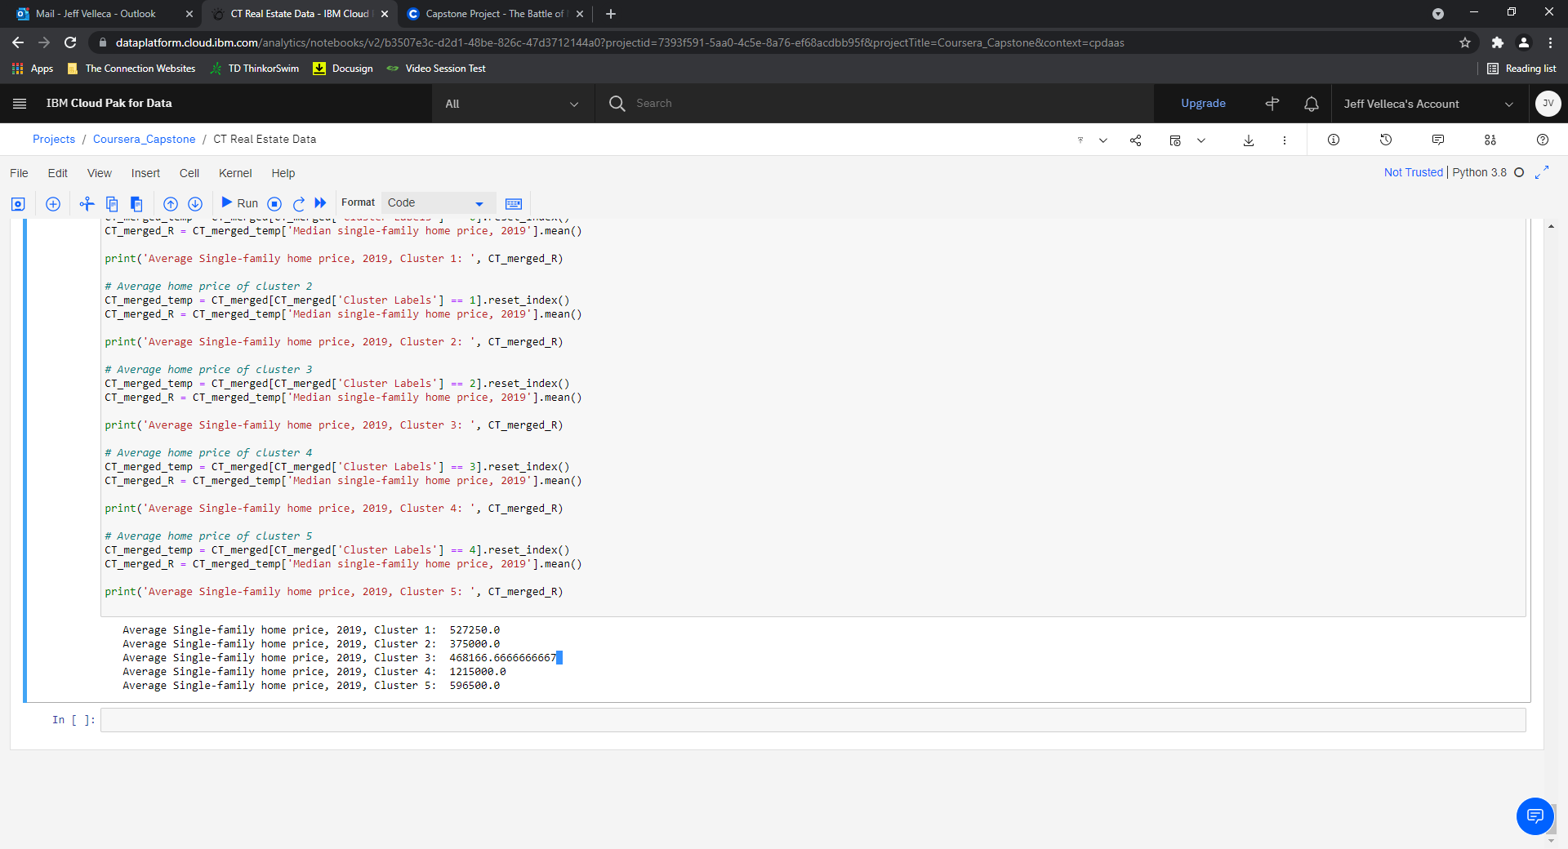
Clusters Continued
Cluster 5
Average Single-family home price, 2019 Clusters

Slide 12
Discussion
Cluster 4 and 5 best opportunity for Return on Investment (ROI)
Cluster 4 and 5 have single family home price range of $596,500 (Cluster 5) - $1,215,000 (Cluster 4)
Cluster 4 most common venue = “Gym”
Cluster 5 variety of venue categories = “Bookstore”, “Butcher”, “Concert Hall”, “Garden”, “Gym/Fitness Center”, “Scenic Lookout”, “State Park”
Opportunity for a Real Estate investment firm to determine whether residential real estate or commercial (venue) investments might yield the highest return on investment
Different approaches can be tried in clustering that might yield different results. This should be further explored in future studies.

Slide 13
Conclusion
As a result of this study several interesting hypotheses were determined:
Fairfield County, CT has the highest median single family home prices
Within Fairfield County, there are 100 different venue categories providing a wide range of entertainment, activities, restaurants, and social involvement.
Of the Clustered venue categories based on Median single-family price we have determined that the Real estate investment opportunity resides in Cluster 4 or 5 providing a home price range of almost 600k to 1.2 million dollars. Of those two Clusters, Cluster 5 provided a wider range of venue categories.

Slide 14
References
Forsquare API
https://www.connecticutmag.com/issues/features/real-estate-2020-the-stats-on-connecticut-towns-and-cities/article_5b21a36a-687b-11ea-8a7e-534f5cf472a2.html
Microsoft Excel Geography Data Type

